Slide 1
Literary Criticism (BA-TY)
Dr. Nirmala S. Padmavat
Director, IQAC
Nutan Mahavidyalaya, Selu

Slide 2
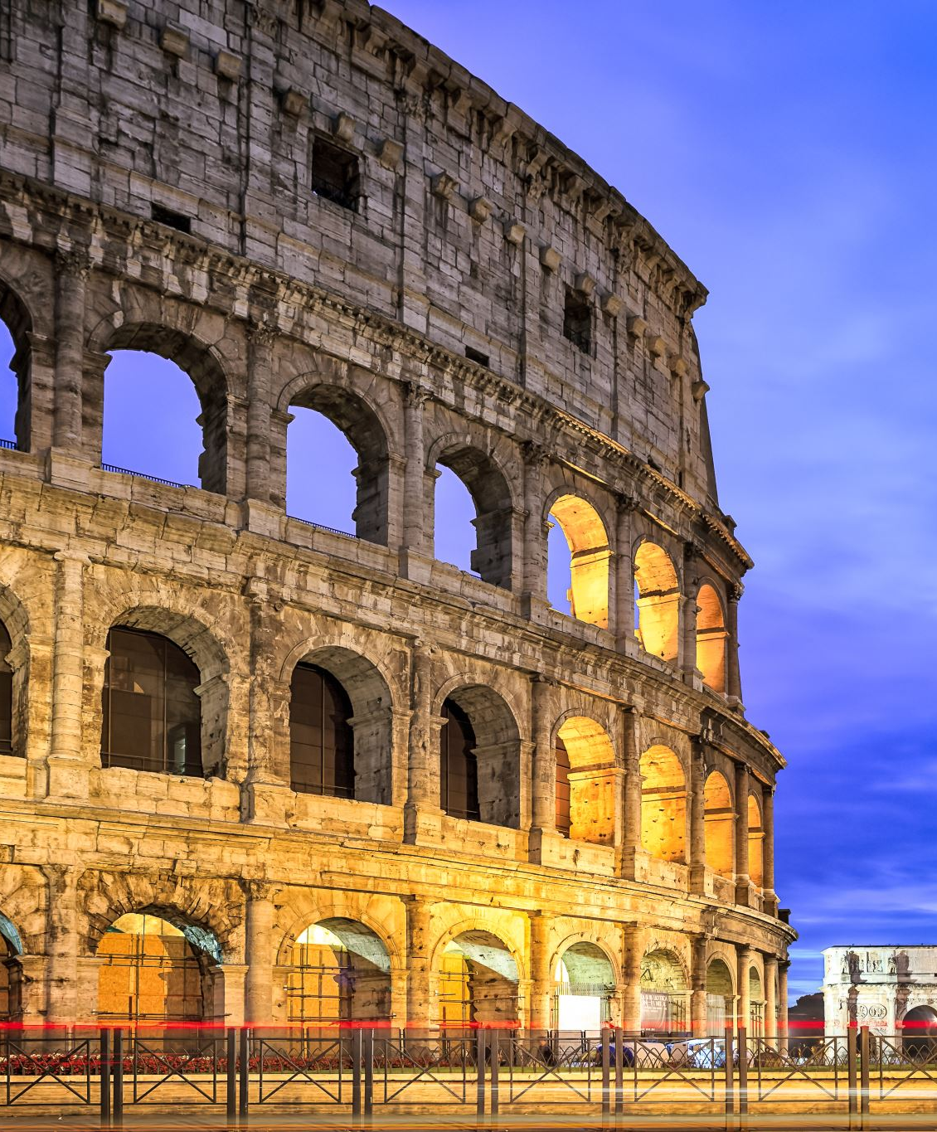
Horace
Early Life : Horace is the Roman classicist; he lived in the glorious Augustine age of Rome. This age was the most important age roman literature. There was the eternal battle between the ancients and moderns. Horace madder the large contribution of all the Roman poets, he was the best critic, and of all the roman critics he was the best poet.

Slide 3
Work of Horace
His works include two books of satires, four books of odes and three books of epistles, the last of which is called the “Ars Poetica” (Art of Poetry). These books can be divided into three divisions:
Poesis – subject matter
Poema – form
Poeta – poet

Slide 4
His Classicism:
There were two schools of writing in Horace’s day the old Latin and modern Alexandrian. The old Latin was the native school of Rome and the Alexandrian was popularized Greek’s scholars of Alexandria. Neither the Alexandrian nor the old Latin mode of poetry was adequate for the mighty themes. Only the ancient Greek models were equal to the mighty call the poet had to answer.
Hence began a new moment in Roman literature – the revival of the ancient Greek tradition in preference to the Alexandrian and the old Latin. Horace was at one with origin in opting for this revived tradition in roman literature. But while Virgil demonstrated it’s new, found splendour in creative work only.

Slide 5
His Classicism:
Horace did so both in his creative work and in his critical writing. Thus, there is a close correspondence between what he practices and what he preaches or as pope puts it. His percepts teach but what his works inspire. His criticism therefore generally follows the ancient classical line and often merely consists of direct transcripts from Aristotle.
Horace was the admirer of the Greek models so he advises the future writer to devote attention to the Greek models. He says: “You, my friends stuffy the great originals of Greece, dream of them by night and ponder them by day”. In this way as Horace aptly puts it the conquered Greece conquered her roman emperor.

Slide 6
Horace’s Observation on Poetry
In ‘Ars Poetica’, Horace talks about nature, function, subject matters, kinds, language and relative importance of nature and art.
Nature of Poetry:
Horace nowhere calls poetry as a process of imitation like Plato and Aristotle, but he remarks implies the same meaning. Horace says ‘I would advise the well instructed imitator to take his model from life and customs’. To Horace a mere imitation of life is not the whole nature of poetry. Horace suggests that a poet should use fiction and mingle facts with fancy; a poet should add something of his own. Horace says a fiction compose to please should be very near to the truth.

Slide 7
Horace’s Observation on Poetry
Function of Poetry:
Plato states that teaching is the function of poetry. Aristotle says that pleasure is the end of poetry, but Horace synthesizes the two contradictory approaches of Plato and Aristotle and says: “poets desire either to improve or to please, or to unite the agreeable and the profitable”. According to Horace the great poetry should be both pleasure giving and morally improving. According to Horace poetry should charm the mind. This Horace emphasizes the duel function – the hedonistic as well as the utilitarian.

Slide 8
Horace’s Observation on Poetry
Subject Matter of Poetry:
Horace has given two observations on the subject matter. He says, “Let your theme be what it may, it should be simple and uniform and choose a theme suited to your powers, are authors, and ponder long what weight your shoulders refuse to bear what they can support”.
Horace advocates a simple theme, it means, from familiar material, or from life and custom. Such simple theme can be made graceful by imparting to power of order and connection or skill in craftsmanship. It has to be uniform or one whole it means irrelevant or extraneous matter should not be in hand. Horace says who chooses his subject wisely will find that neither neighter woerds nor lucid arrangement fail him.

Slide 9
Horace’s Observation on Poetry
Kinds of Poetry:
Horace believes that poetry has settled kinds and these are based on a meter appropriate to each or the epic. Horace advises the use of the dactylic hexameter because epic deals with high subject.
For the mournful elegy and songs or thanks giving, the elegiac measure or a couplet, of which, the first line is a dactylic hexameter and second a dactylic pentameter.
For tragedy, comedy and satirical works which deal with familiar things, the iambi meter is suitable because it has a conventional ease.

Slide 10
Horace’s Observation on Poetry
Language of Poetry:
Following Aristotle, Horace also emphasizes the right choice of words and heir effective arrangement in composition.
A poet is free to use both familiar words and new if they fulfil the two requirements of expression clearness and effectiveness.
Horace says that poet is free to choose any kind of words, familiar, new, coined and even archaic, if it satisfies the demands of uses. The poet’s skill lies in making the familiar words appear strange and strange ones familiar. The author must show taste and clear in linking them up their lucid arrangement is the most important for beauty and charm.

Slide 11
Horace’s Observation on Poetry
Nature and Art:
Horace has examined the vexed question of the place of genius and art in the success of a poem. The natural endowment is called nature and training in the literary art is called art. In this context, Horace says that “No one can be a great artist unless he is naturally gifted and unless he undertakes the necessary toil to learn the principles of his craft”. Horace says the both nature and art are indivisible this conclusion is also warranted by Horace’s happy gift of compromise.

Slide 12
Horace’s Observations on Drama:
Horace’s observations on drama are interesting more for his debt to Aristotle than for anything new he has to say. Horace studies drama broadly under three heads: Plot, Characterization and Style

Slide 13
Plot
According to Horace plot should be borrowed familiar material, preferably the known Greek legends. The author should show his skill or originality in the matter of treatment.
If on untried new theme was to be chosen, it should be consistent from the beginning to the end. Only the relevant events of the story should be joined into an unbreakable union.
Events repugnant to sight or difficult to believe should be reported epic wise rather than shown on the stage because what is heard is less shocking or incredible than what is seen for the same reason.
As a tragedy constructed on the Greek model it should have chorus, it should from an integral part of the plot so as not disturbed unity of action.

Slide 14
Characterization
In characterization also the dramatist can choose from the ancient Greek legends or invent new characters. If the character is from the ancient Greek legends is should be consistent true to their traditional prototypes. Horace demands truth to life or verisimilitude in a character.
A child in a play should behave like a child, young like a young man, a middle aged man like an old man, an old man like an old man.

Slide 15
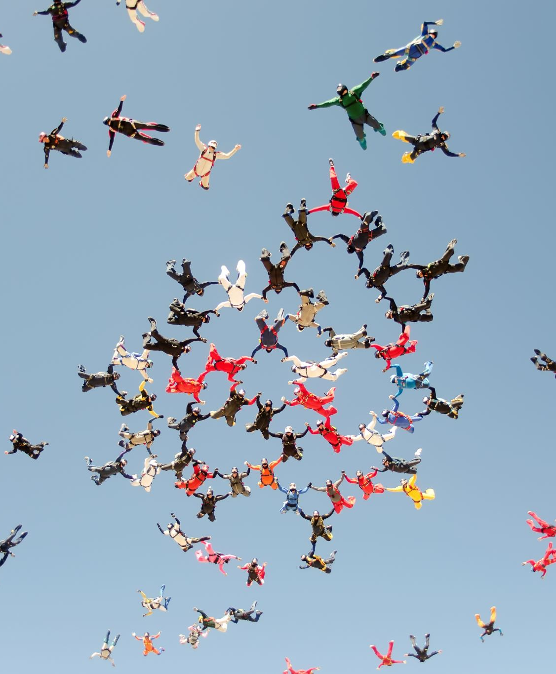
Style
Horace says that for drama, both tragedy and comedy the iambic meter is most suitable, firstly because it is nearer to the spoken speech and secondly because with every second syllable of it pronounced louder than the first, it could be heard about the din of the audience. Dramatic speech should observe properly; it should suit the character of its sex, its station in life, its circumstances, and its moods.

Slide 16
Conclusion
God will speak differently from a mortal, a man from a woman, an aged man from a heated youth, a prosperous merchant from a poor farmer, a man in grief from a man in joy, an angry fellow from a playful one. In all this Horace closely follows Aristotle

Slide 17
Thank you!

